Slide 1
THE LIFE OF CHRIST
PART 14

Slide 2
John 4:43 Now after the two days He departed from there and went to Galilee. ⁴⁴ For Jesus Himself testified that a prophet has no honor in his own country. ⁴⁵ So when He came to Galilee, the Galileans received Him, having seen all the things He did in Jerusalem at the feast; for they also had gone to the feast.

Slide 3
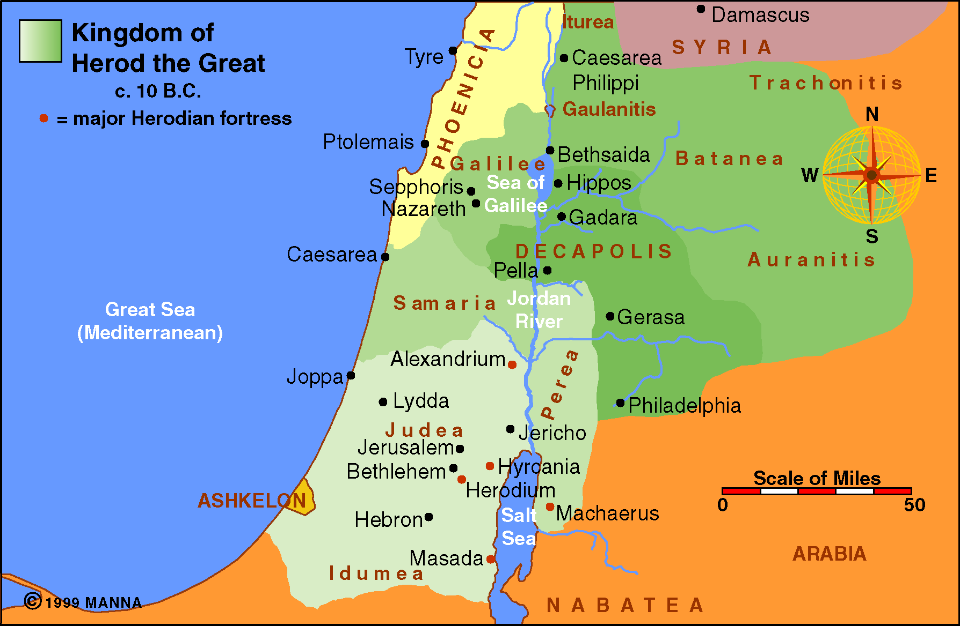
(Mt. 13:57; Mk. 6:4; Lk. 4:24).

Slide 4
John 4:46 So Jesus came again to Cana of Galilee where He had made the water wine. And there was a certain nobleman whose son was sick at Capernaum. ⁴⁷ When he heard that Jesus had come out of Judea into Galilee, he went to Him and implored Him to come down and heal his son, for he was at the point of death. ⁴⁸ Then Jesus said to him, "Unless you people see signs and wonders, you will by no means believe."

Slide 5
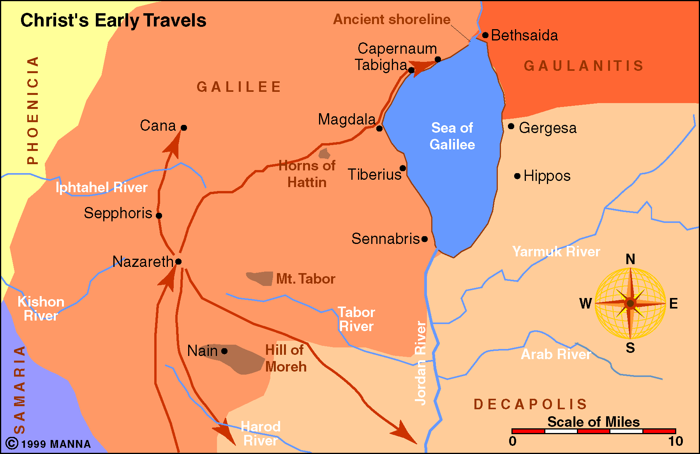
"An evil and adulterous generation seeks after a sign, and no sign will be given to it except the sign of the prophet Jonah. "For as Jonah was three days and three nights in the belly of the great fish, so will the Son of Man be three days and three nights in the heart of the earth” (Mt. 12:39-40).

Slide 6
John 4:49 The nobleman said to Him, "Sir, come down before my child dies!" ⁵⁰ Jesus said to him, "Go your way; your son lives." So the man believed the word that Jesus spoke to him, and he went his way. ⁵¹ And as he was now going down, his servants met him and told him, saying, "Your son lives!" ⁵² Then he inquired of them the hour when he got better. And they said to him, "Yesterday at the seventh hour the fever left him." ⁵³ So the father knew that it was at the same hour in which Jesus said to him, "Your son lives." And he himself believed, and his whole household. ⁵⁴ This again is the second sign Jesus did when He had come out of Judea into Galilee.

Slide 7
Luke 4:16 So He came to Nazareth, where He had been brought up. And as His custom was, He went into the synagogue on the Sabbath day, and stood up to read. ¹⁷ And He was handed the book of the prophet Isaiah. And when He had opened the book, He found the place where it was written: ¹⁸ "The Spirit of the LORD is upon Me, Because He has anointed Me To preach the gospel to the poor; He has sent Me to heal the brokenhearted, To proclaim liberty to the captives And recovery of sight to the blind, To set at liberty those who are oppressed; ¹⁹ To proclaim the acceptable year of the LORD."

Slide 8
²⁰ Then He closed the book, and gave it back to the attendant and sat down. And the eyes of all who were in the synagogue were fixed on Him. ²¹ And He began to say to them, "Today this Scripture is fulfilled in your hearing."

Slide 10
Luke 4:22 So all bore witness to Him, and marveled at the gracious words which proceeded out of His mouth. And they said, "Is this not Joseph's son?"

Slide 11
Luke 4:23 He said to them, "You will surely say this proverb to Me, 'Physician, heal yourself! Whatever we have heard done in Capernaum, do also here in Your country.' " ²⁴ Then He said, "Assuredly, I say to you, no prophet is accepted in his own country.

Slide 12
Luke 4:25 "But I tell you truly, many widows were in Israel in the days of Elijah, when the heaven was shut up three years and six months, and there was a great famine throughout all the land; ²⁶ "but to none of them was Elijah sent except to Zarephath, in the region of Sidon, to a woman who was a widow. ²⁷ "And many lepers were in Israel in the time of Elisha the prophet, and none of them was cleansed except Naaman the Syrian."

Slide 13
Luke 4:28 So all those in the synagogue, when they heard these things, were filled with wrath, ²⁹ and rose up and thrust Him out of the city; and they led Him to the brow of the hill on which their city was built, that they might throw Him down over the cliff. ³⁰ Then passing through the midst of them, He went His way.

Slide 14
Luke 4:31 Then He went down to Capernaum, a city of Galilee, and was teaching them on the Sabbaths. ³² And they were astonished at His teaching, for His word was with authority.

Slide 15
Matthew 4:13 And leaving Nazareth, He came and dwelt in Capernaum, which is by the sea, in the regions of Zebulun and Naphtali, ¹⁴ that it might be fulfilled which was spoken by Isaiah the prophet, saying: ¹⁵ "The land of Zebulun and the land of Naphtali, By the way of the sea, beyond the Jordan, Galilee of the Gentiles: ¹⁶ The people who sat in darkness have seen a great light, And upon those who sat in the region and shadow of death Light has dawned." ¹⁷ From that time Jesus began to preach and to say, "Repent, for the kingdom of heaven is at hand."

Slide 16
Mark 1:15 "The time is fulfilled, and the kingdom of God is at hand. Repent, and believe in the gospel."

Slide 17
Next Jesus is going to start gathering up some men that would later become apostles. The first gathering is 4 fishermen. Both Matthew and Mark record this event (Mt. 4:18-22; Mk. 1:16-20).

Slide 18
Mark 1:16 And as He walked by the Sea of Galilee, He saw Simon and Andrew his brother casting a net into the sea; for they were fishermen. ¹⁷ Then Jesus said to them, "Follow Me, and I will make you become fishers of men." ¹⁸ They immediately left their nets and followed Him. ¹⁹ When He had gone a little farther from there, He saw James the son of Zebedee, and John his brother, who also were in the boat mending their nets. ²⁰ And immediately He called them, and they left their father Zebedee in the boat with the hired servants, and went after Him.

Slide 19
Luke 5:1 So it was, as the multitude pressed about Him to hear the word of God, that He stood by the Lake of Gennesaret, ² and saw two boats standing by the lake; but the fishermen had gone from them and were washing their nets. ³ Then He got into one of the boats, which was Simon's, and asked him to put out a little from the land. And He sat down and taught the multitudes from the boat. ⁴ When He had stopped speaking, He said to Simon, "Launch out into the deep and let down your nets for a catch." ⁵ But Simon answered and said to Him, "Master, we have toiled all night and caught nothing; nevertheless at Your word I will let down the net." ⁶ And when they had done this, they caught a great number of fish, and their net was breaking.

Slide 20
⁷ So they signaled to their partners in the other boat to come and help them. And they came and filled both the boats, so that they began to sink. ⁸ When Simon Peter saw it, he fell down at Jesus' knees, saying, "Depart from me, for I am a sinful man, O Lord!" ⁹ For he and all who were with him were astonished at the catch of fish which they had taken; ¹⁰ and so also were James and John, the sons of Zebedee, who were partners with Simon. And Jesus said to Simon, "Do not be afraid. From now on you will catch men." ¹¹ So when they had brought their boats to land, they forsook all and followed Him.

Slide 21
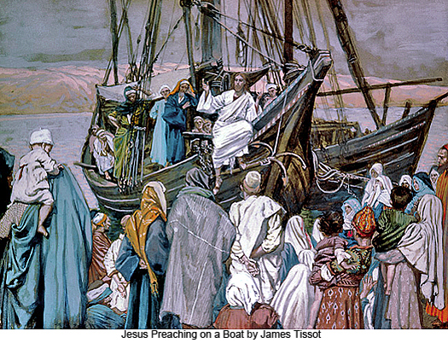
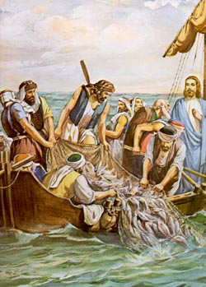

Slide 22
Mark 1:21 Then they went into Capernaum, and immediately on the Sabbath He entered the synagogue and taught. ²² And they were astonished at His teaching, for He taught them as one having authority, and not as the scribes.

Slide 23
Mark 1:23 Now there was a man in their synagogue with an unclean spirit. And he cried out, ²⁴ saying, "Let us alone! What have we to do with You, Jesus of Nazareth? Did You come to destroy us? I know who You are -- the Holy One of God!" (See also Lk. 4:33-37)

Slide 24
Mark 1:25 But Jesus rebuked him, saying, "Be quiet, and come out of him!" ²⁶ And when the unclean spirit had convulsed him and cried out with a loud voice, he came out of him. ²⁷ Then they were all amazed, so that they questioned among themselves, saying, "What is this? What new doctrine is this? For with authority He commands even the unclean spirits, and they obey Him." ²⁸ And immediately His fame spread throughout all the region around Galilee.

Slide 25
Luke 4:38 Now He arose from the synagogue and entered Simon's house. But Simon's wife's mother was sick with a high fever, and they made request of Him concerning her. ³⁹ So He stood over her and rebuked the fever, and it left her. And immediately she arose and served them. See also Mark 1:29-31 and Mt. 8:14-17.

Slide 26
Mark 1:31 So He came and took her by the hand and lifted her up, and immediately the fever left her. And she served them.

Slide 27
Luke 4:40 When the sun was setting, all those who had any that were sick with various diseases brought them to Him; and He laid His hands on every one of them and healed them. ⁴¹ And demons also came out of many, crying out and saying, "You are the Christ, the Son of God!" And He, rebuking them, did not allow them to speak, for they knew that He was the Christ. See also Mt. 8:16-17; Mk. 1: 32-34.

Slide 28
Matthew 8:16 And He cast out the spirits with a word, and healed all who were sick, ¹⁷ that it might be fulfilled which was spoken by Isaiah the prophet, saying: "He Himself took our infirmities And bore our sicknesses."

Slide 29
Mark 1:35 Now in the morning, having risen a long while before daylight, He went out and departed to a solitary place; and there He prayed. ³⁶ And Simon and those who were with Him searched for Him. ³⁷ When they found Him, they said to Him, "Everyone is looking for You." ³⁸ But He said to them, "Let us go into the next towns, that I may preach there also, because for this purpose I have come forth.” ³⁹And He was preaching in their synagogues throughout all Galilee, and casting out demons. See also Lk. 4:42-43.

